Slide 1
PO Line number and title Included in subject of claim letter
Yoel Kortick
Senior Librarian

Slide 2
Introduction
Setting it up
Example for Physical One Time POL

Slide 3
Introduction

Slide 4
Introduction
The March 2019 release includes a new option to configure the subject of the PO Line Claim letter (letter code: POLineClaimLetter).
For all PO line types, the PO line number and title can be included in the email subject.
If the PO line type is physical continuous, the item description can also be included. For non-predicted continuous orders, the expected received date can be included.

Slide 5
Introduction
This feature greatly enhances communication with vendor.
The vendor immediately knows the order number and title when receiving the letter, and for POLs of type continuous the vendor also knows that specific issue is being claimed.

Slide 6
Setting it up
The fields for the Subject are available in the new_subject field.
The field is set by entering your text within <> + field name. The format is as follows:
<My Title Text: > title <My Ref Num Text: > poline_reference_number <My Item Desc Text: > item_description

Slide 7
Setting it up
Following are the fields that can be used within the subject field:
  title
  poline_reference_number
  item_description - only for Physical Continuous type
  identifier_type and item_identifier
In our example we will set the email subject of the PO Line Claim Letter as follows:
<Title : > title <Order Number: > poline_reference_number <Item: > item_description

Slide 8
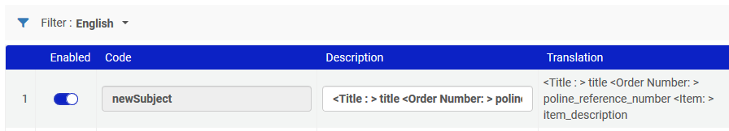
Setting it up
For example:

Slide 9
Example for Physical One Time POL

Slide 10
Example for Physical One Time POL
We will now look at a claim for POL-45441, title "Women at the top : powerful leaders tell us how to combine work and family".
It is in status "Sent" with a receiving date of July 1, 2019, which is over a month ago.

Slide 11
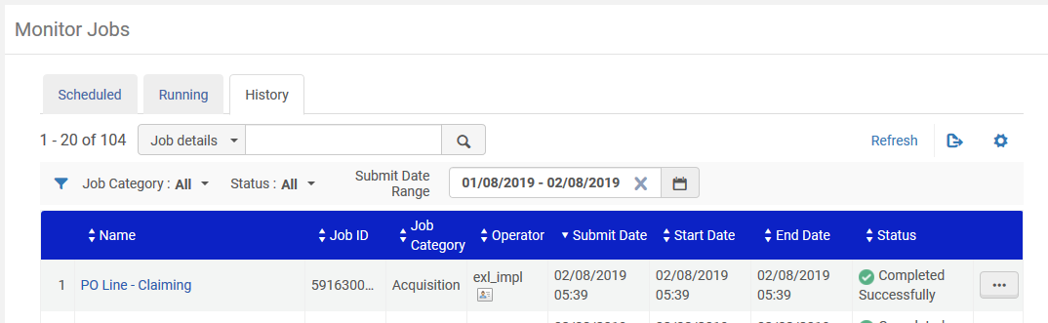
Example for Physical One Time POL
The regularly scheduled job "PO Line Claiming" runs

Slide 12
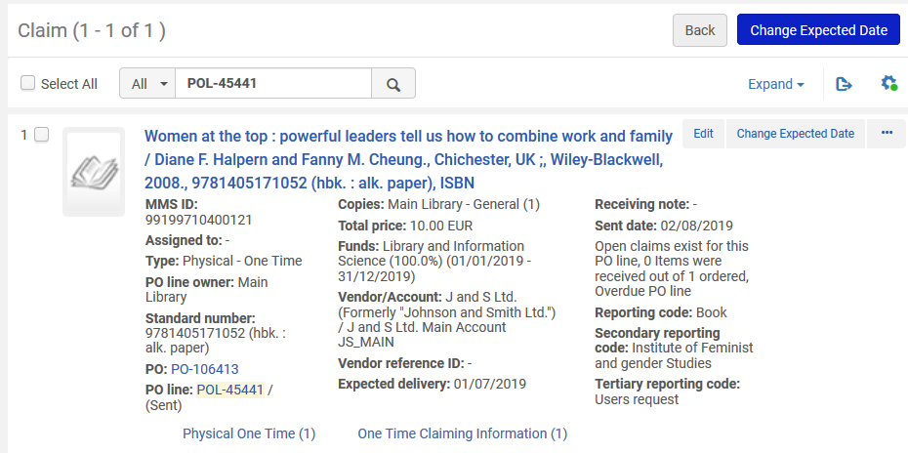
Example for Physical One Time POL
The POL goes to the Claims Task List

Slide 13
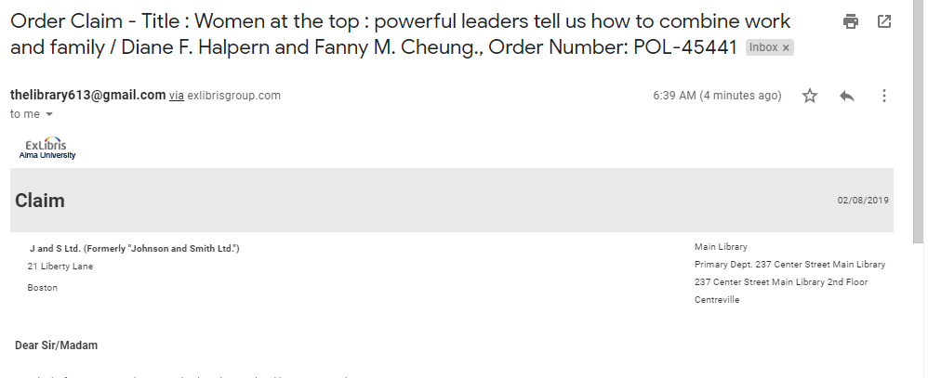
Example for Physical One Time POL
The claim letter arrives with title and POL number in the subject

